Slide 1

Dale Richards
Competency Portfolio
www.infratec-uk.com

Slide 2
Competency Summary
Category | Accreditation Body | No. | Expiry
Lorry Loader – Capacity up to: Unlimited Categories: D1+E | ALLMI | 238601 | 02/07/2026
Slinger/Signaler | ALLMI | 204697 | 06/06/2027
Emergency First aid at work (Lvl 3) | Qualsafe Awards | 3024683 | 14/02/2026
Highways Electrical Registration Scheme | HEA | H1174753 | 05/11/2027
Confined space Safe Entry & Self Rescue | IIRSM | CS-02 10059 | 12/02/2026
Working at Height Level 2 (RQF) | Qualsafe | 3021031 | 15/02/2026
National Highways Safety Passport | National Highways | 14-00013945 | 06/01/2026
Counterbalance Forklift Truck | A1 Forklift | TH5520 | 24/05/2029
www.infratec-uk.com

Slide 3
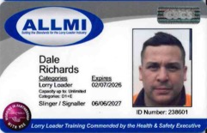
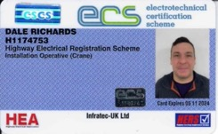
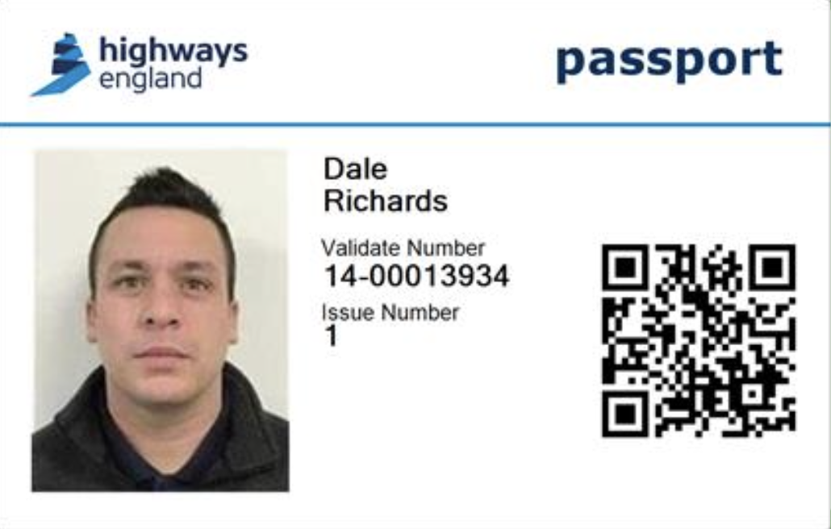
Competency Cards
ALLMI
HERS
NH Passport
www.infratec-uk.com

